Slide 1
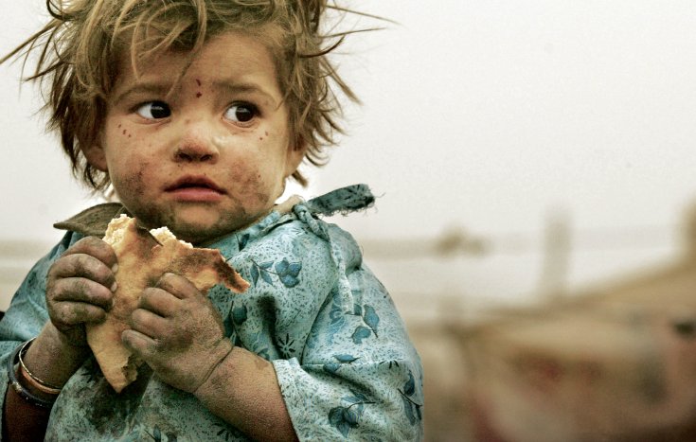

RISE AGAINST HUNGER DW PROJECT
Emre Ozden 4547248 Viktoriya Bodnar 4473240

Slide 2
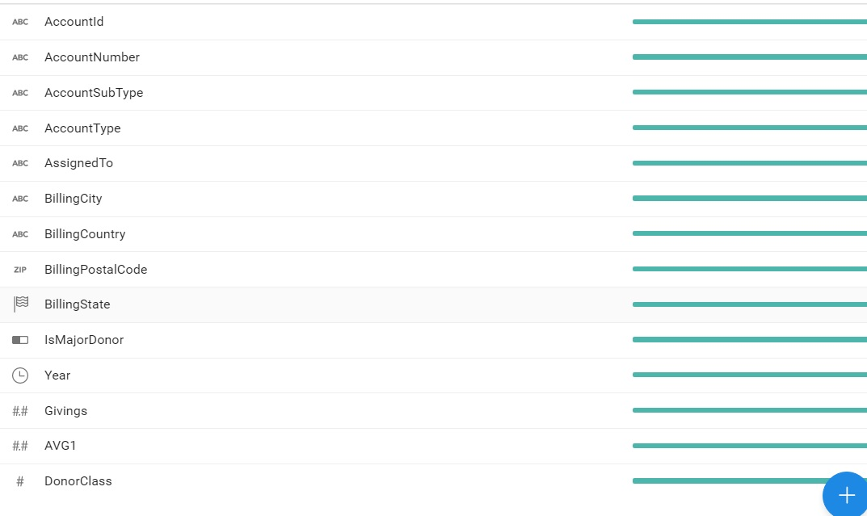
Motivation and Data inspection
Fact | Dimensions | Measures | History
Monetary Donation | Time, Donor, Place, DonationLevel* | TotalAmount, AverageAmount(AVG) | Period from 2010 to 2016
- who are the donors?
- the variation of the monetary donations with
respect to time, countries and different donation levels?
Identified problems:
missing data
irrelevant data
inaccurate values
non explanatory fields etc.
Proposed improvements:
Merging check
column transformation
donation classification

Slide 3
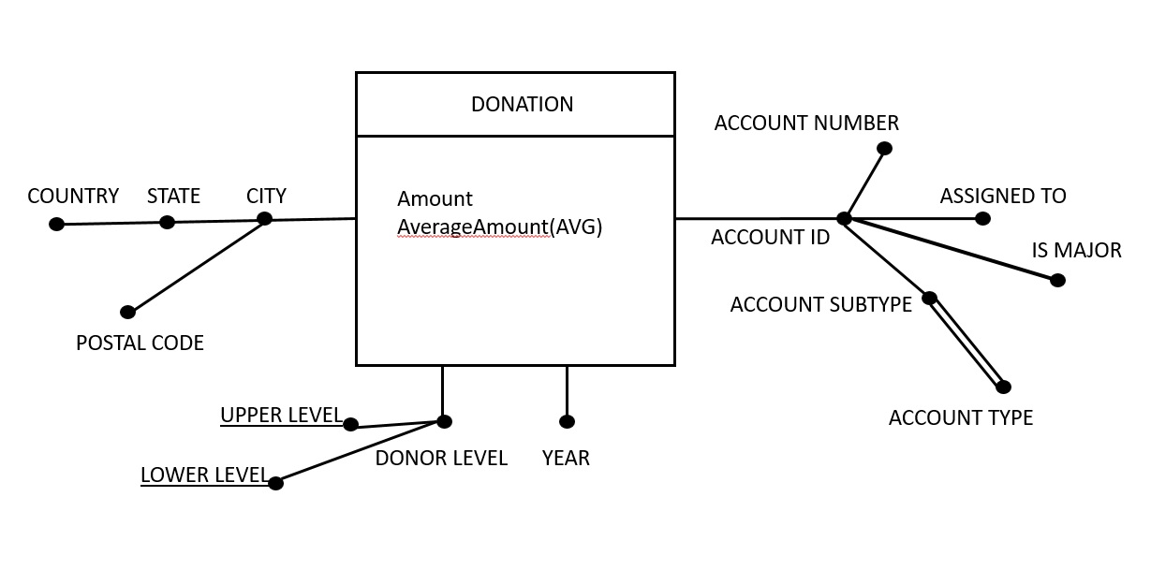
DFM
Attribute hierarchies, multiple arch, descriptive attributes, added measures...

Slide 4
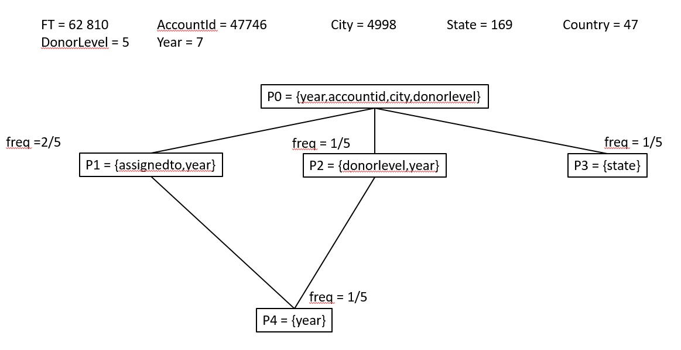
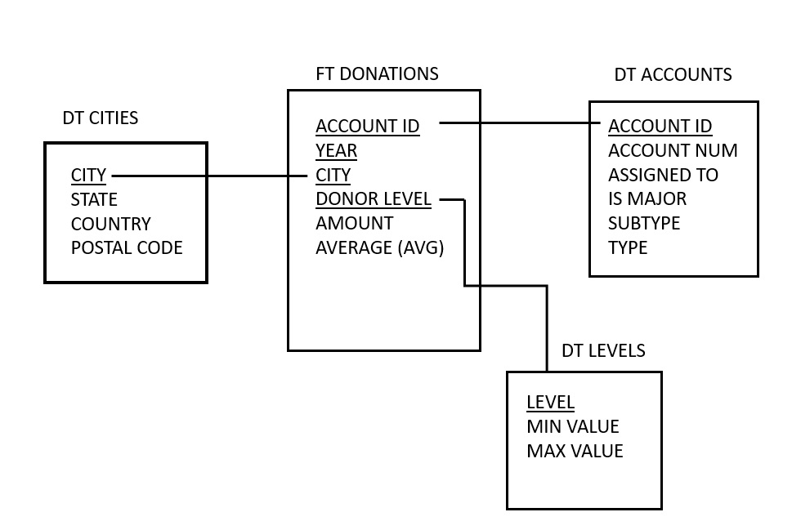
ROLAP
Star schema, ft and dt tables, no secondary dt tables,views

Slide 5
OLAP + HIVE + SPARK
Partitions → account
Rank functions → donor + total donation
Frames → mobile average
Hive partitions and clusters → year/country+city & accountid
Spark dataframes and transformations → benefits of DF API

Slide 6
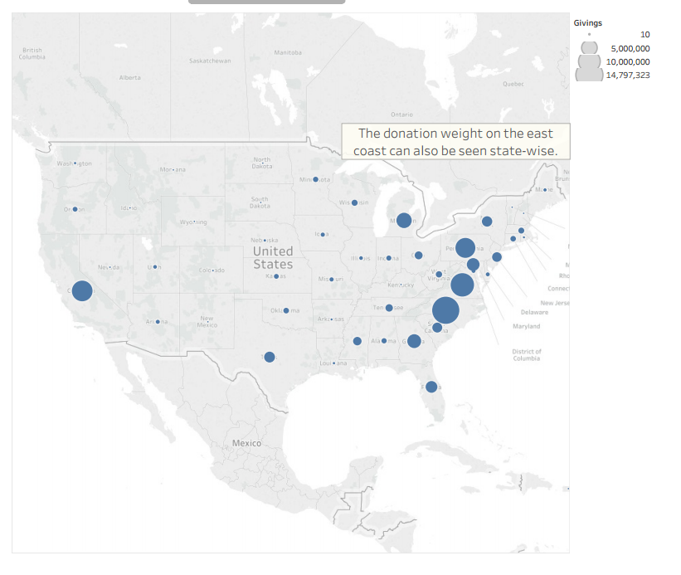
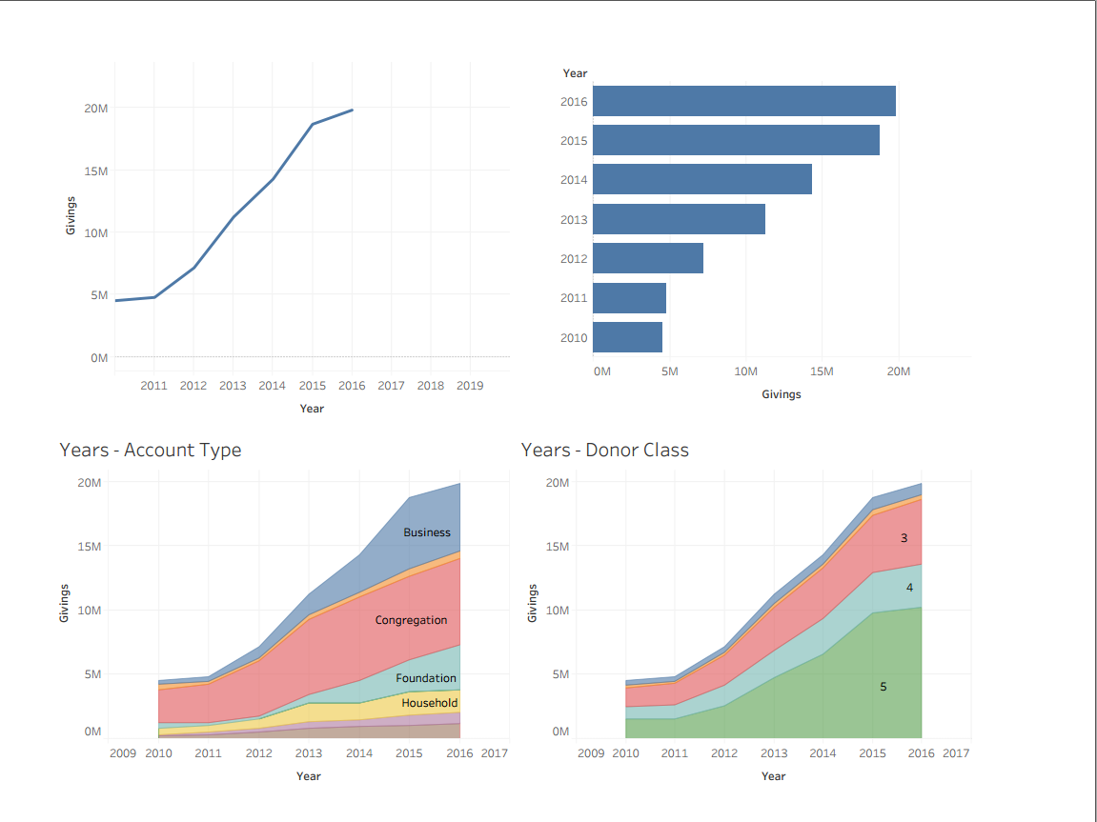
Data visualization

Slide 7

Thanks for your attention

